Slide 1
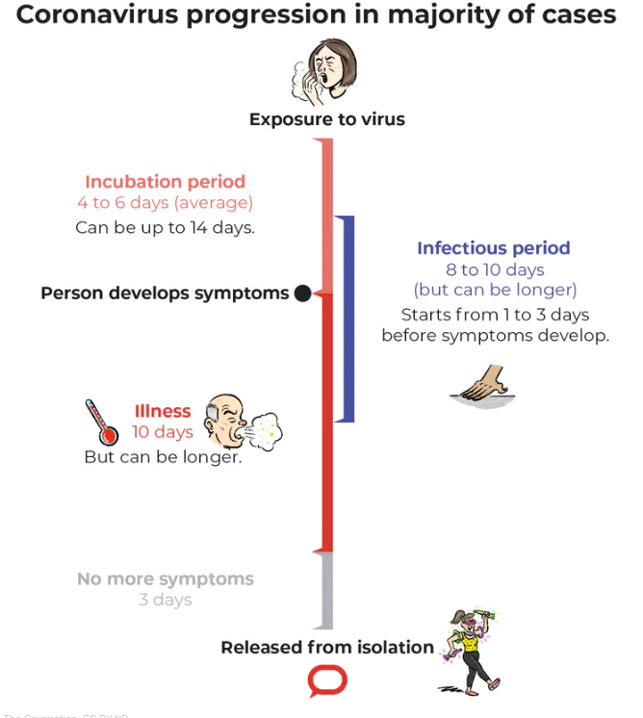

Slide 2
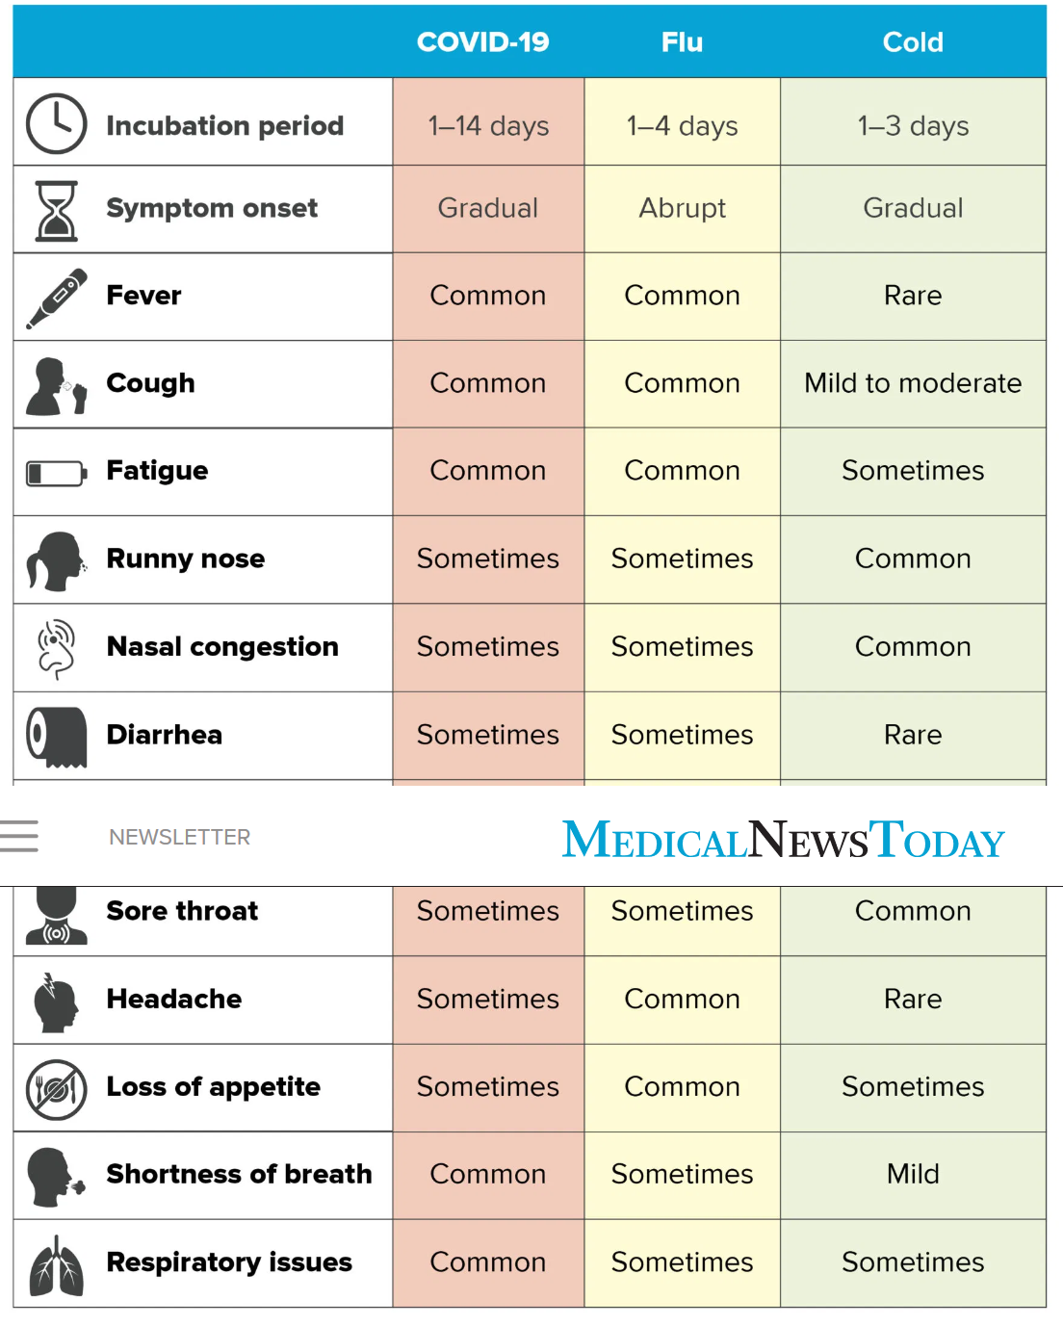

Slide 4
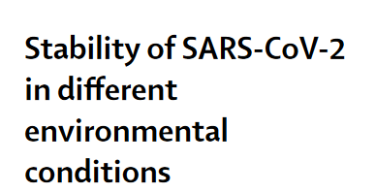
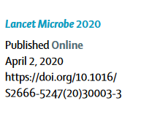
Printing and tissue paper: 3 hours
Wood and cloth: 2 days
Glass and banknotes: 4 days
Stainless steel and plastic: 7 days
OUTSIDE OF SURGICAL MASKS: 7 days

Slide 5
Casual and Close Contacts
Close: >15 mins at <1 m without PPE
Or unprotected exposure to fluids/aerosol-generating procedures
Casual
Anything else!

Slide 6
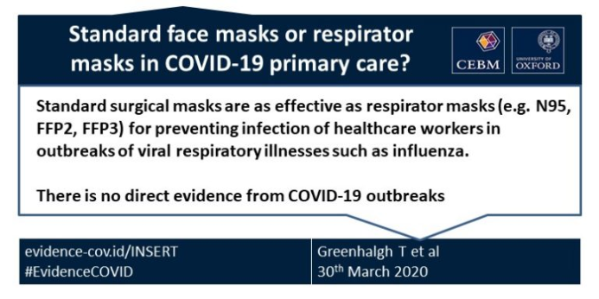
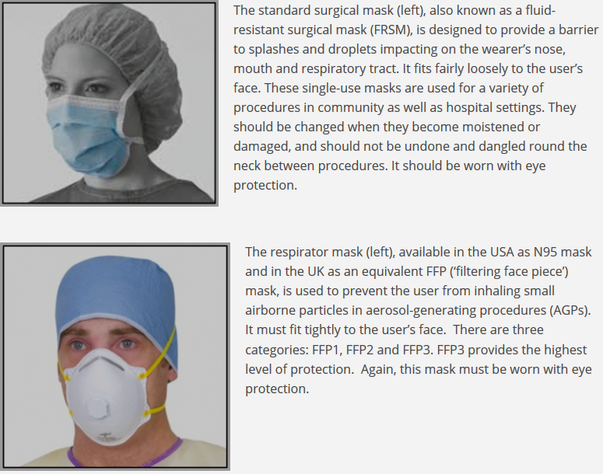

Slide 7
Aerosol-Generating Procedures
Needs higher level of PPE
  CPR (specific guidelines)
  Intubation, bronchoscopy – don’t try these!!

